Slide 1
Final Project Presentation
Spencer Cribby

Slide 2
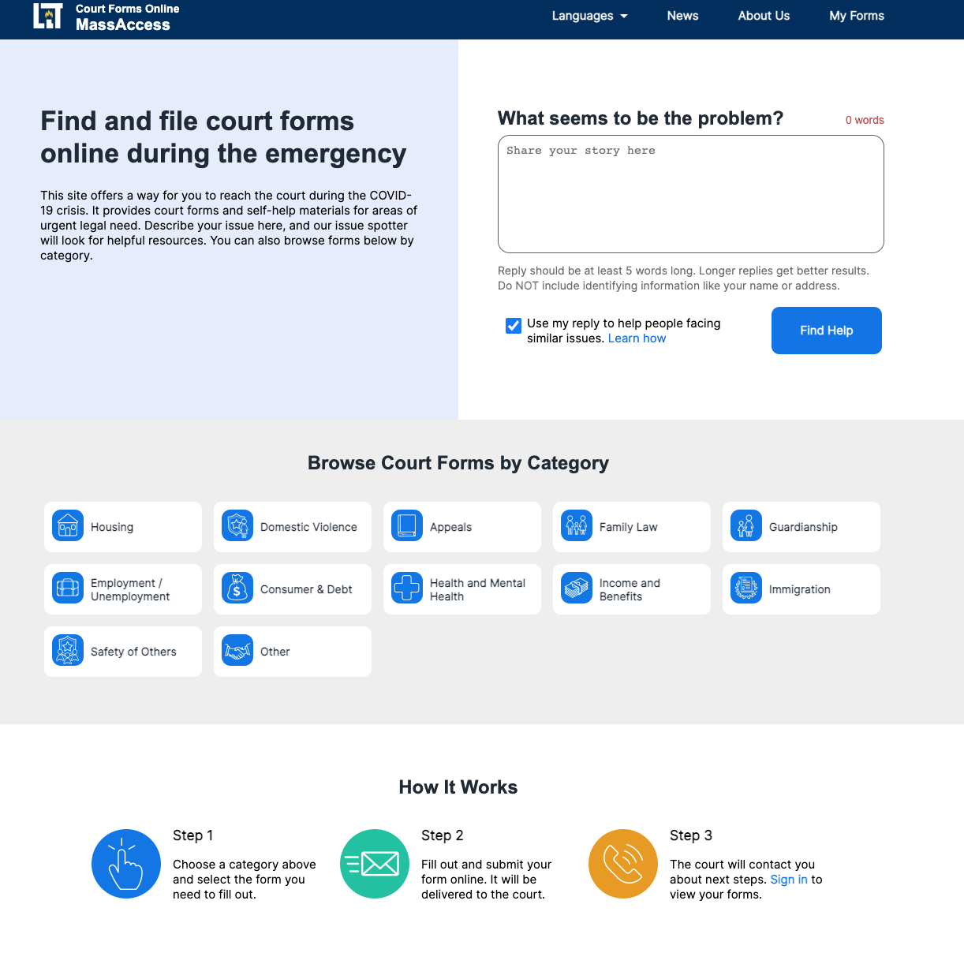
Assembly Line

Slide 3
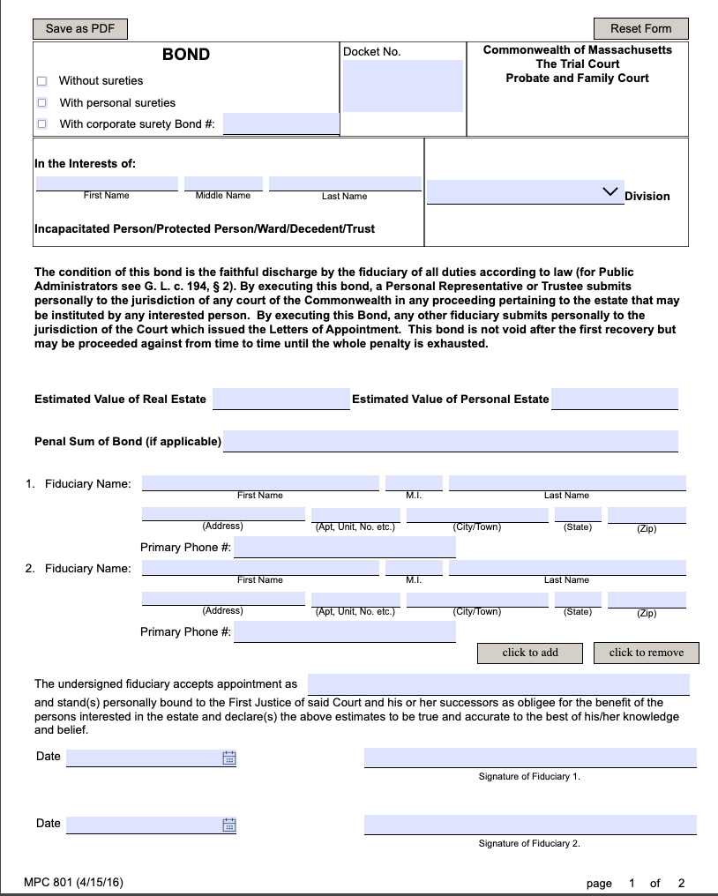
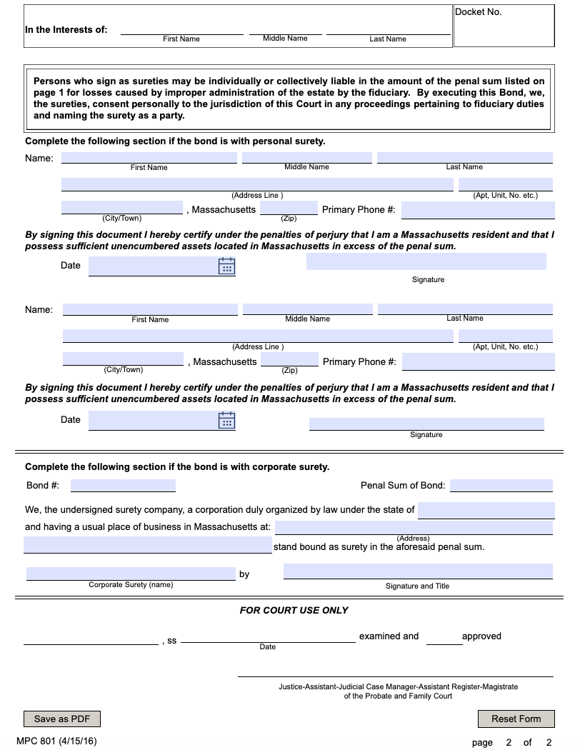
Form

Slide 4
#justiceforjay

Slide 5
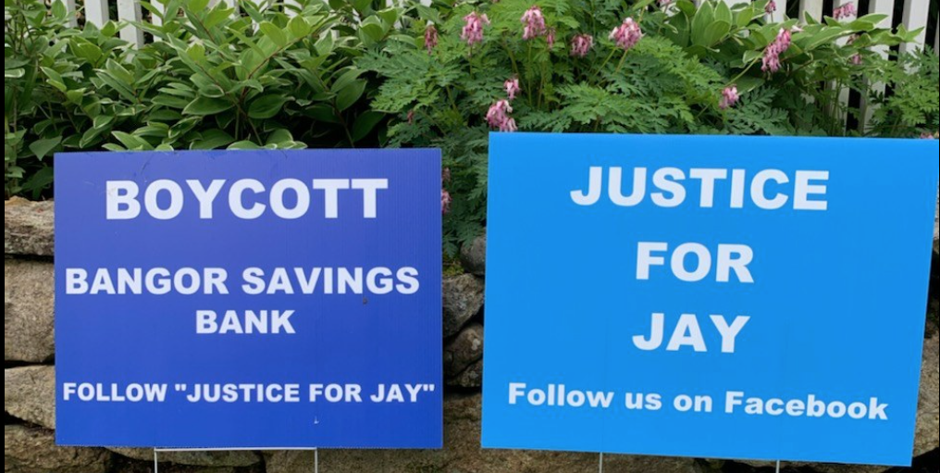

Slide 6


Slide 7


Slide 8

scribby@su.suffolk.edu

